Slide 1
Interview Presentation
Summary of My Learnings as a Machine Learning Engineer Candidate
Reshma M | Machine Learning Engineer Candidate | Tachyon Systems

Slide 2

Machine Learning Fundamentals: The Foundation
Machine Learning enables computers to learn patterns from data and improve over time without being explicitly programmed.
Supervised Learning
Unsupervised Learning
Reinforcement Learning
Definition: Learning from labeled data (input-output pairs).
Definition: Learning patterns from unlabeled data (only inputs).
Definition: Learning by interacting with an environment, receiving rewards/penalties.
Examples:
Examples:
Regression, Classification.
Clustering, Dimensionality Reduction.
Examples:
Game-playing agents, Robotics.1
My journey into machine learning began with understanding these foundational principles. Grasping the distinction between different learning paradigms and the ultimate aim of generalization has been crucial in approaching any ML problem.

Slide 3

Data Preprocessing:
Data preprocessing involves data cleaning, feature engineering, and feature scaling to improve model performance.
Data Cleaning helps handling nuances like missing values, outliers, and categorical encoding which transforms raw data into a high-quality datasets.
Feature engineering helps transforming input features to improve model's performance.
Feature scaling helps bringing features to a similar range, usually through standardization or normalization.
Preprocessing = Cleaning data + Engineering features + Scaling values → Better model accuracy and stability.
I've learned that effective data preprocessing lays the groundwork for any successful ML project. It's often the most time-consuming yet rewarding phase, directly impacting the final model's efficacy.

Slide 4

Model Development: From Algorithms to Solutions
Algorithm Selection
Training & Optimization
Evaluation & Validation
The journey from raw data to a deployable solution involves a structured approach to model development. My learnings have focused on a systematic selection, training, and objective evaluation.
Algorithm Selection: This critical choice depends entirely on the task at hand – being it classification, regression, clustering, etc..,
Training & Optimization: Once an algorithm is chosen, the model parameters are meticulously optimized to minimize error on the training data.
Evaluation & Validation: The final stage uses metrics like accuracy, precision, recall, and F1-score to validate the model's performance.

Slide 5

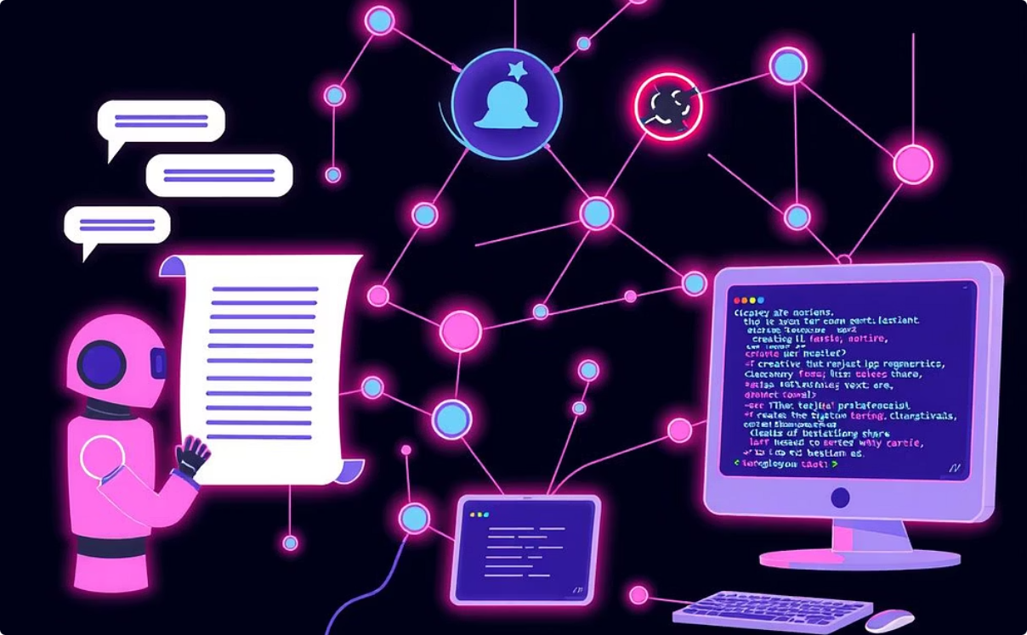
Large Language Models (LLMs) & Generative AI: The New Frontier
Human-Like Generation
Diverse Applications (LLaMA)
LLMs, exemplified by models like GPT, leverage deep learning to produce text that mirrors human communication.
Generative AI is revolutionizing fields from chatbots and sophisticated content creation to automated code generation.
Diverse applications of LLMs include models like GPT, LLaMA, and Mistral, powering tasks such as chatbots, summarization, translation, and generative AI.”This area is rapidly evolving, and I'm constantly learning about new advancements.

Slide 6




Retrieval-Augmented Generation (RAG): Enhancing AI with External Knowledge
Integrating External Data
Improved Factual Accuracy
Dynamic, Up-to-Date Responses
RAG enhances LLMs by allowing them to access and incorporate information from external, authoritative databases.
This integration significantly improves the factual accuracy and relevance of generated responses.
RAG enables dynamic responses that are reflecting the latest information available in the integrated databases.
Real-world Use Case
Imagine a customer support bot that can retrieve specific, real-time product information from a company's knowledge base to answer customer queries, providing precise and helpful assistance.

Slide 7

Embeddings: Representing Data in Vector Space
Embeddings are a fundamental concept in modern machine learning, they involve converting complex data types—like text, images, or audio—into dense numerical vectors in a high-dimensional space.
The brilliance of embeddings lies in their ability to capture the semantic meaning and relationships within the data. Data points that are semantically similar are mapped to nearby points in this vector space.
Similarity Search
Clustering
Recommendation Systems
My learning on embeddings,underscores their power in enabling sophisticated NLP tasks and making sense of vast, unstructured data.

Slide 8
Cloud ML Platforms: Scalable Model Training & Deployment
Cloud Machine Learning Platforms are indispensable for modern ML operations, providing the infrastructure and tools needed to scale and manage complex workflows.
Streamlined Workflows
Managed Infrastructure
Operational Support
Platforms like AWS SageMaker, Azure ML, and Google Vertex AI offer integrated environments that simplify the entire ML lifecycle.
They provide fully managed services for data processing, large-scale model training, & hyperparameter tuning.
These platforms are crucial for facilitating team collaboration, version control, and continuous monitoring of models.

Slide 9
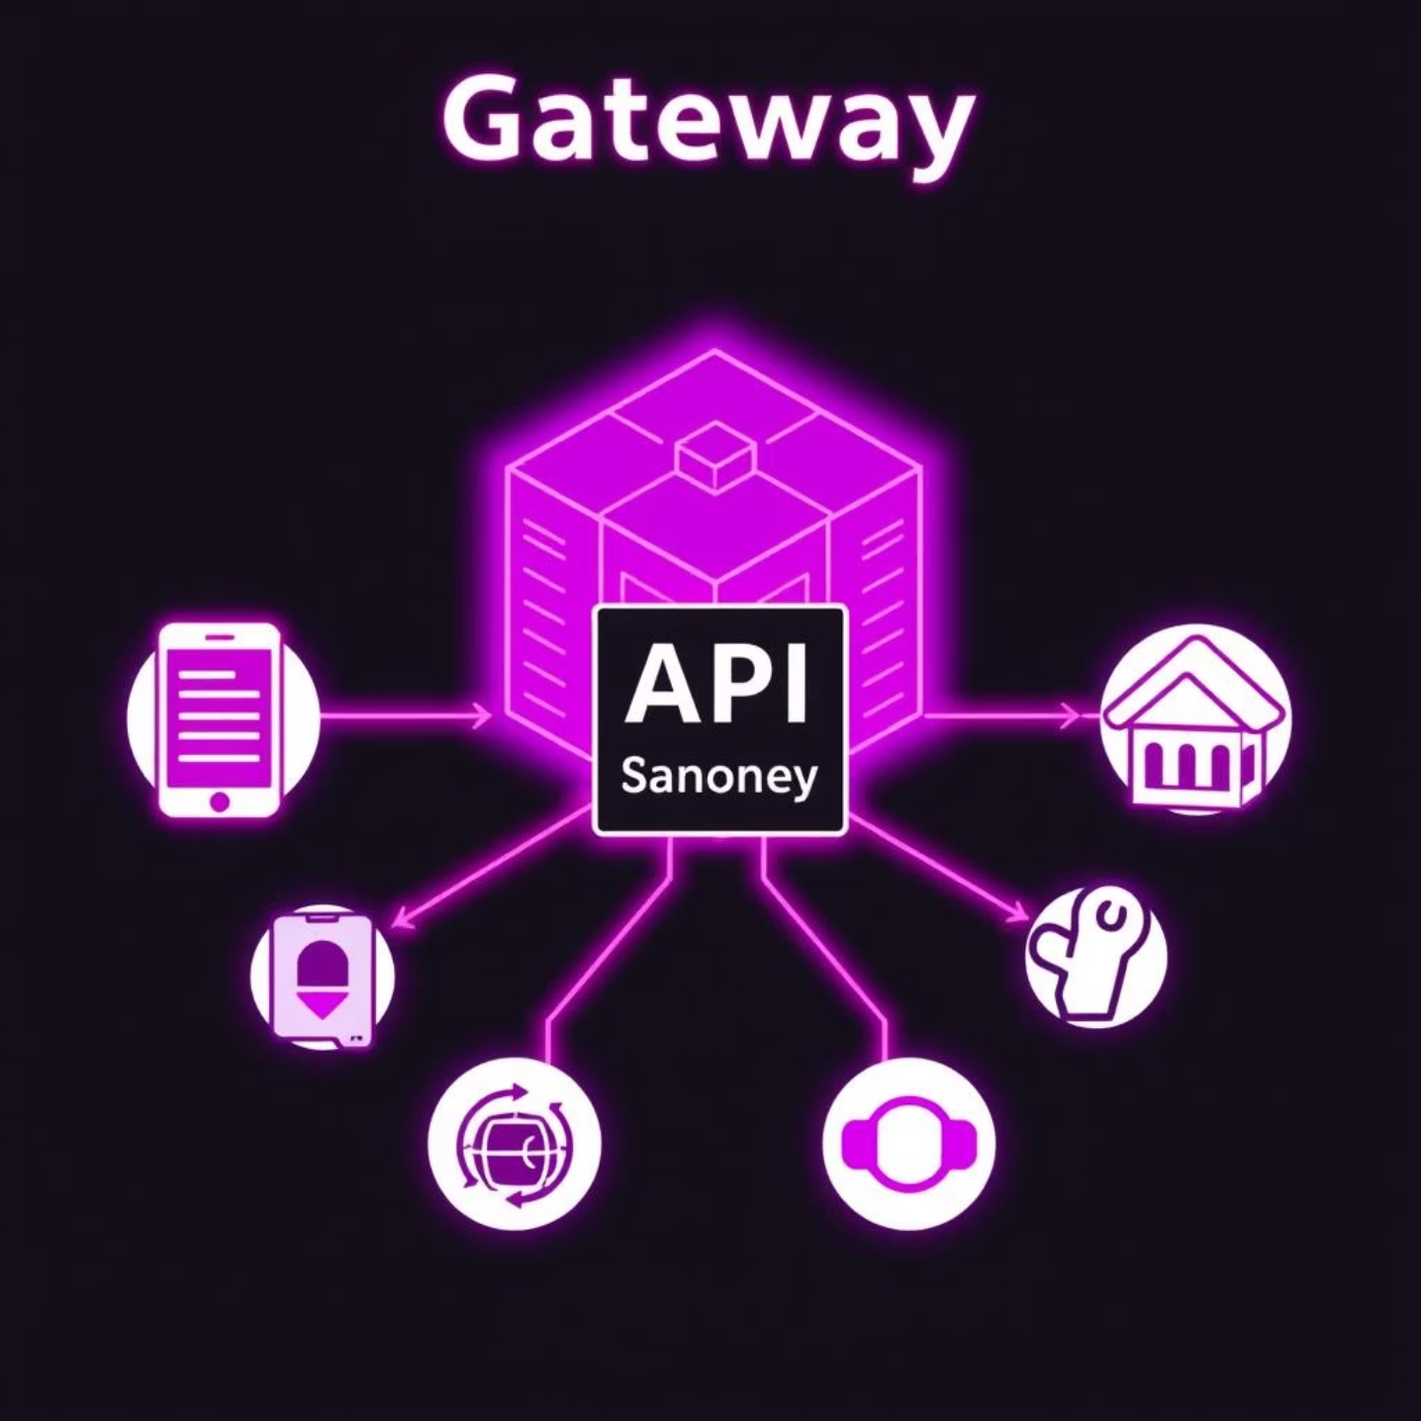

API Integration: Bridging Models with Applications
API Integration is the crucial final step that brings machine learning models out of development environments and into the hands of users.
By exposing ML models through well-defined RESTful APIs, we enable seamless communication and functionality within broader applications and services.
Real-time Inference
Scalability
Cross-platform Accessibility
Why is this critical?
Without robust API integration, even the most sophisticated ML model remains an isolated artifact, unable to deliver its value to end-users or other systems. It's the pipeline that transforms potential into impact.

Slide 10
System Design for ML
System design for ML focuses on building end-to-end pipelines for data collection, training, and deployment.
Architecting Pipelines : Designing an automated workflow that handles the complete
Data Ingestion and Preprocessing
Model Training and Evaluation
Deployment and Monitoring
Serving the trained model via APIs.
Collecting raw data.
Building and Optimizing Models.
Cleaning, Feature engineering and Scaling.
Tracking Performance if needed.
Testing with metrics.

Slide 11

Containerization & Deployment
Containerizing models ensures consistent environments and easy scaling.
Deployment makes trained models available in production, often through APIs or cloud services.
Together, they enable scalability, portability, and reliable real-time predictions.
Serverless Interaction
Dockizing enables ML models to run in serverless platforms, where infrastructure is abstracted and models can be invoked only when needed.
Example: Dockized model serving with Kubernetes for automated scaling and updates.

Slide 12
Monitoring & MLOps
Monitoring tracks model performance after deployment (accuracy, latency, drift).
Model Degradation
Track Quality
Real-time Alerts
Models degrade over time due to concept and data drift.
Monitor data distribution, prediction accuracy in production.
Tools like Evidently provide instant diagnostics.
MLOps is the practice of managing the end-to-end ML lifecycle.
Combines ML, DevOps, and Data Engineering principles.
Helps detect model drift and supports continuous retraining.
MLOps provides the framework to automate training, deployment, and monitoring.

Slide 13
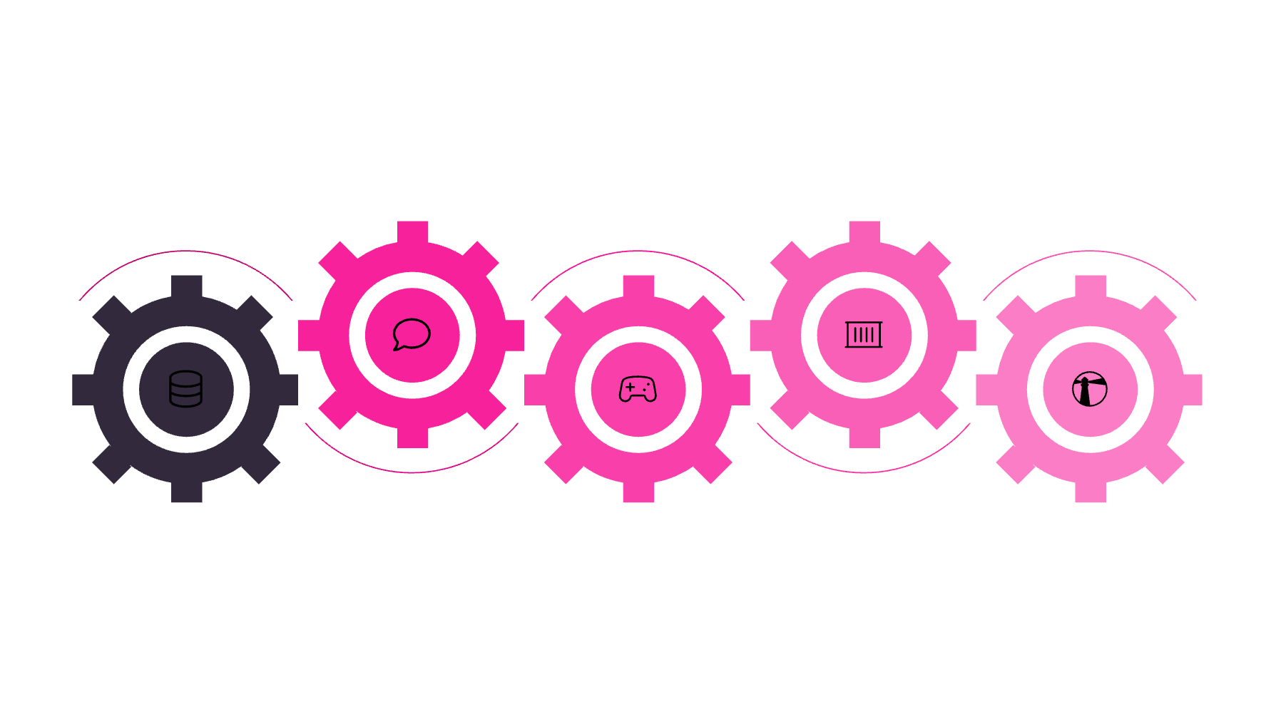





Visualizing the ML Lifecycle with MLOps
Containerized Deployment
Feature Engineering
Create and transform features
Package models for production
Data Ingestion
Model Training
Monitoring & Alerting
Collect and stream raw data
Train and validate models
Track performance and send alerts

Slide 14
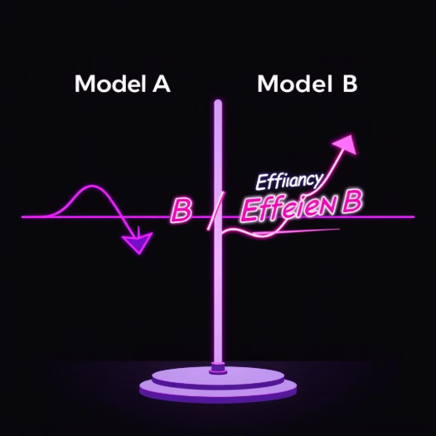
Detecting Drift & A/B Testing
Model drift
A/B Testing
Model drift detection ensures ML models stay relevant as real-world data evolves.
Compares model versions to validate improvements before rollout.
Types:
Helps decide which model/feature to deploy in production for improved performance.
Concept Drift
Changes in data patterns affecting model predictions.
Data Drift
Shifts in input data distribution impacting reliability.

Slide 15



Security in ML Pipelines
Security in ML pipelines Prevents data breaches, model theft, and adversarial attacks that can compromise ML systems.
Secured ML systems produces accurate, trustworthy predictions.
Protecting Data & Models Across the ML Lifecycle
Data Security
Model Security
Infrastructure Security
Encrypt PII (Personally Identifiable Information) at rest and in transit.
Guard against theft and adversarial attacks.
Secure containers, update dependencies, isolate networks.

Slide 16
Closing: My Vision as a Machine Learning Engineer
Impact at Tachyon Systems: I am genuinely excited by the opportunity to contribute to Tachyon Systems’ goals, by leveraging data-driven intelligence to foster innovation and achieve strategic objectives.
Thank you for your consideration!.

